Slide 1


Superstore Sales DashboAnalysis
Interactive Dashboard
Prepared by: sriharidevalla
Data Analyst Internship - Task 3
June 5, 2025

Slide 2

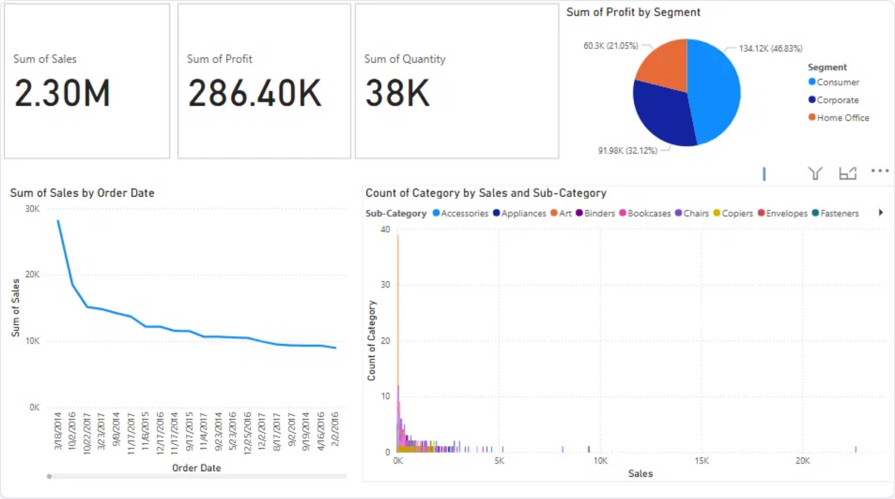





Dashboard Overview
Internship_Task4_Dashboard.pbix - Main Dashboard View
Dashboard Components
This Power BI dashboard provides a comprehensive view of Superstore sales performance through several key visualizations:
Key Metrics Cards
Data Visualizations
Sum of Sales:
$2.30M
Profit by Customer Segment (pie chart)
Sum of Profit:
$286.40K
Sales Trend by Order Date (line chart)
Sum of Quantity:
38K
units
Category by Sales and Sub-Category (scatter plot)
Dashboard Purpose:
This dashboard enables stakeholders to monitor key sales metrics, analyze customer segment performance, track sales trends over time, and explore product category distribution.

Slide 3





Key Performance Indicators
Dashboard KPI Analysis
The dashboard displays three critical business metrics that provide an at-a-glance performance overview:
$2.30M
$286.40K
38K
Total Sales
Total Profit
Units Sold
KPI Insights
Profit Margin Analysis
Average Order Value
Based on the KPIs, the overall profit margin is approximately
The average revenue per unit is approximately
$60.53
12.45%
($286.40K profit on $2.30M sales).
($2.30M sales / 38K units).
This indicates a healthy profit margin for retail, suggesting effective pricing strategies and cost management.
This suggests a mid-to-high price point product mix, typical for an office supply and technology retailer.
Profit per Unit
KPI Relationships
The average profit per unit is approximately
$7.54
The dashboard shows a direct relationship between sales volume and profit generation, with consistent profit margins across the business.
($286.40K profit / 38K units).
This metric helps in evaluating product performance and can guide inventory and purchasing decisions.
These KPIs provide a foundation for deeper analysis of segment and category performance.

Slide 4




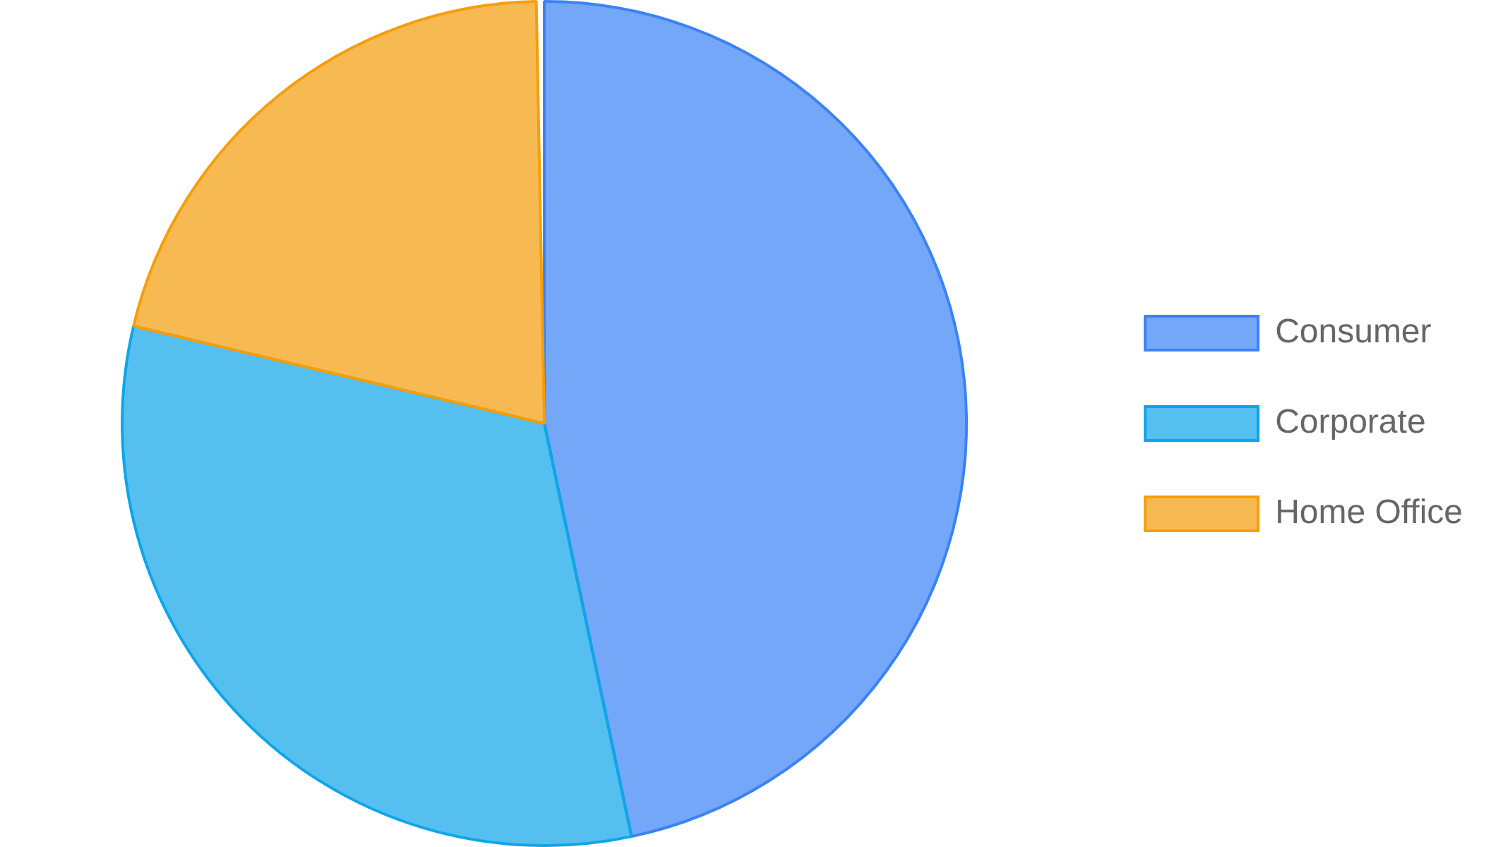




Profit by Customer Segment
Segment Distribution
Segment Breakdown
The dashboard shows profit distribution across three customer segments, with Consumer segment leading in contribution.
Consumer
$134.12K
Profit Contribution
46.83%
Corporate
$91.98K
Profit Contribution
32.12%
Home Office
$60.3K
Profit Contribution
21.05%
Segment Performance Insights
Strategic Implications
Consumer segment
Focus marketing efforts on the Consumer segment to maximize return on investment.
generates the highest profit at $134.12K (46.83% of total), making it the most valuable customer group.
Develop targeted growth strategies for the Corporate segment to increase market share.
Corporate customers
contribute $91.98K (32.12%), representing significant business potential with room for growth.
Evaluate product offerings for Home Office to identify opportunities for expansion.
Home Office
Consider segment-specific promotions based on profit contribution patterns.
is the smallest segment at $60.3K (21.05%), but still represents over one-fifth of total profits.

Slide 5

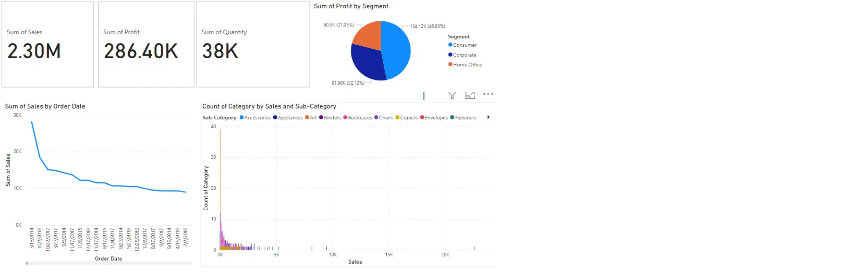
Sales Trends Analysis
Sales by Order Date
The dashboard shows a clear sales trend over time, with notable patterns visible in the "Sum of Sales by Order Date" line chart.
Initial Sales Peak
Gradual Decline
The chart shows a significant sales peak at the beginning of the time period (around 30K), followed by a sharp decline.
After the initial peak, sales show a gradual declining trend over time, stabilizing around the 10K level in later periods.
Seasonal Fluctuations
Recent Stabilization
The line chart reveals minor fluctuations throughout the timeline, suggesting possible seasonal or periodic sales patterns.
Toward the end of the timeline, sales appear to stabilize, indicating a potential market equilibrium or consistent customer base.
Strategic Implications
Historical Context:
Investigate the factors behind the initial high sales peak to understand if it was a one-time event or a repeatable success.
Trend Analysis:
The overall declining trend suggests a need to evaluate product lifecycle, market saturation, or competitive pressures.
Forecasting:
The recent stabilization provides a baseline for future sales projections and inventory planning.
Growth Opportunities:
Consider marketing initiatives or product innovations to reverse the declining trend and stimulate new growth.

Slide 6











Category & Sub-Category Analysis
Count of Category by Sales and Sub-Category
The dashboard includes a scatter plot visualization showing the count of categories by sales and sub-categories, revealing product distribution patterns.
Key Observations
Visible Sub-Categories
The scatter plot shows a concentration of sub-categories in the lower sales range (below 5K).
Accessories
Appliances
Several sub-categories show higher counts (vertical axis) but relatively lower sales.
Art
Binders
A few outlier sub-categories appear in the higher sales ranges (10K-20K).
Bookcases
Chairs
Copiers
Envelopes
The color-coding in the visualization distinguishes between different sub-categories.
Business Insights
Product Diversity
Sales Distribution
The wide spread of sub-categories indicates a diverse product portfolio, which helps mitigate risk but may dilute focus.
Most sub-categories generate lower sales volumes, with a few high-performers driving significant revenue.
Inventory Optimization
Growth Opportunities
High-count, low-sales sub-categories may indicate inventory inefficiencies that could be addressed.
Identifying which sub-categories are outliers in the higher sales ranges can inform product expansion strategies.

Slide 7











Key Insights & Recommendations
Key Dashboard Insights
Overall Business Performance
With $2.30M in sales and $286.40K in profit, the business maintains a healthy 12.45% profit margin across 38K units sold.
This indicates effective pricing strategies and operational efficiency in the retail environment.
Customer Segment Dominance
Consumer segment drives 46.83% of total profits ($134.12K), making it the most valuable customer group.
Corporate (32.12%) and Home Office (21.05%) segments provide balanced diversification but show growth potential.
Sales Trend Patterns
The sales trend shows an initial peak followed by gradual decline and recent stabilization around 10K levels.
This pattern suggests market maturation and the need for strategic initiatives to stimulate growth.
Product Portfolio Diversity
The scatter plot reveals a diverse product portfolio with multiple sub-categories, most concentrated in lower sales ranges.
This diversity provides risk mitigation but may indicate opportunities for portfolio optimization.
Strategic Recommendations
Focus on Consumer Segment
Grow Corporate Business
Invest heavily in consumer marketing and product development, as this segment generates the highest profit contribution and shows strong performance.
Develop targeted B2B strategies to increase corporate segment share, potentially through volume discounts and specialized service offerings.
Reverse Sales Decline
Optimize Product Mix
Implement growth initiatives such as new product launches, market expansion, or promotional campaigns to counter the declining sales trend.
Analyze low-performing sub-categories for potential discontinuation and focus resources on high-performing product lines.

Slide 8









Dashboard Interactivity
Interactive Features in r Dashboard
Thisr Internship_Task4_Dashboard.pbix includes several interactive features that enhance data exploration:
Data Slicers
Cross-Filtering
This dashboard includes interactive filters that allow users to focus on specific data segments:
This dashboard supports cross-filtering between visualizations:
Sub-Category filter (visible in the dashboard)
Click on a segment in the pie chart to filter other visuals
Date range filtering capabilities
Select points in the scatter plot to see related data
Segment selection options
Click time periods in the line chart to focus on specific timeframes
Enhanced Tooltips
Drill-Down Capability
Hovering over data points reveals detailed information:
Thisr dashboard supports exploring data at different levels:
Sales, Profit, and Quantity details
Percentage contribution to totals
Time: Drill from year to quarter to month
Contextual information based on the visualization
Categories: Explore from category to sub-category
Segments: Analyze detailed segment performance
How to Use Interactive Features
Try these interactions with dashboard:
1
Click on the "Consumer" segment in the pie chart to filter all visuals to show only Consumer data
2
Use the Sub-Category filter to focus on specific product types and observe changes across all charts
3
Click on specific time periods in the sales trend chart to analyze performance in those periods
4
Hover over data points to view detailed tooltips with additional context and metrics

Slide 9



Next Steps & Conclusion
Dashboard Summary
This Internship_Task4_Dashboard.pbix successfully demonstrates key data analysis skills through:
Clear KPI visualization ($2.30M sales, $286.40K profit)
Time-series trend visualization
Product category distribution insights
Effective customer segment analysis

